Slide 1
Stack

Slide 2
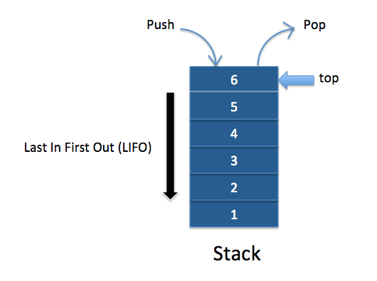
Stack
LIFO(Last In First Out)
Basic Operations on Stack
Push()
Pop()

Slide 3
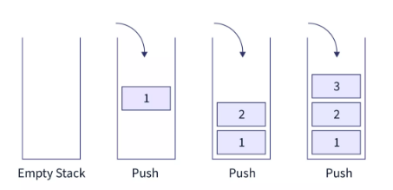
Push Operation

Slide 4
Algorithm for Push Operation
begin procedure push: stack, data
if stack is full
return null
endif
top ← top + 1
stack[top] ← data
end procedure

Slide 5
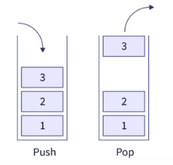
Pop Operation

Slide 6
Algorithm for Pop Operation
begin procedure pop: stack, data
if stack is empty
return null
endif
data ← stack[top]
top ← top - 1
return data
end procedure

Slide 7
Supporting Stack Functions
peek() − get the top data element of the stack, without removing it.
isFull() − check if stack is full.
isEmpty() − check if stack is empty.

Slide 8
Algorithm of peek() function
begin procedure peek
return stack[top]
end procedure

Slide 9
Algorithm of isfull() function
begin procedure isfull
if top equals to MAXSIZE
return true
else
return false
endif
end procedure

Slide 10
Algorithm of isempty() function
begin procedure isempty
if top = -1
return true
else
return false
endif
end procedure

